Slide 1


Slide 2



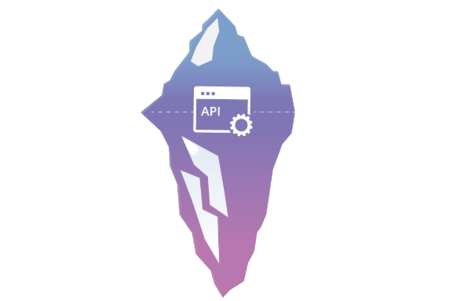
Front-End
Backend
Backend
Every thing of the internet running behind the scenes

Slide 3
Backend
#1
Request and response cycle
Exchange of data between the user and the server
#2
Get and Post requests
GET is used for viewing something, without changing it, while POST is used for changing something.
#3
Authentication
Authentication is the process of recognizing a user’s identity.

Slide 4
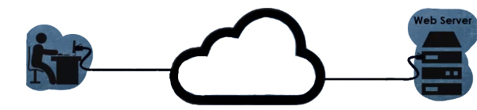
Request and response cycle
Request
Internet
Response

Slide 5
Request and response cycle
Request
Internet
Response

Slide 6

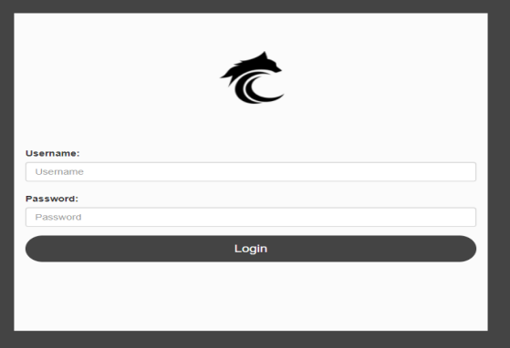
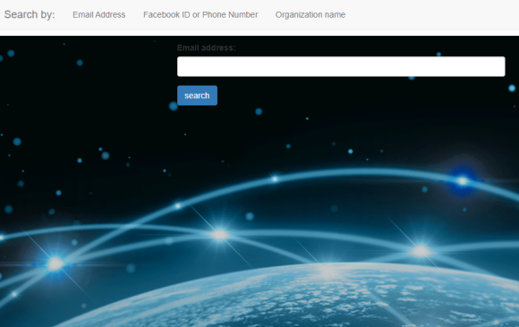
GET
Request
POST

Slide 7




Authentication
Login
Username
Password
Logged in
Not valid
Check credentials
valid

Slide 8
Authentication
Login
Username
Password
Logged in
Not valid
Check credentials
valid

Slide 9
Session
Authentication
X
Login
Username
Password

Slide 10


Services
POST Request
GET / POST Request
Tool
GET Request
GET Request
Valid
Create session
Response
Not Valid
Response

Slide 11
Services
POST Request
GET / POST Request
Tool
Backend
GET Request
GET Request
Valid
Create session
Response
Not Valid
Response

Slide 12

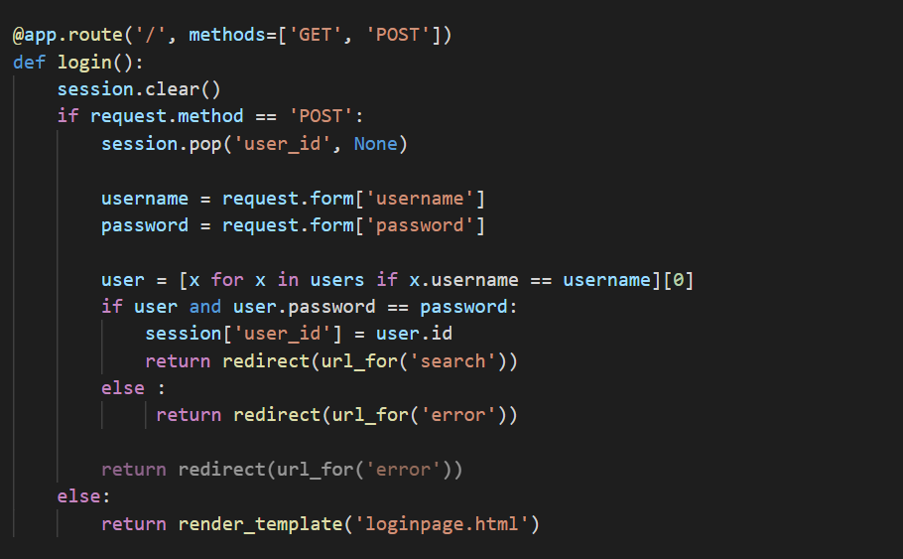
Coding

Slide 14


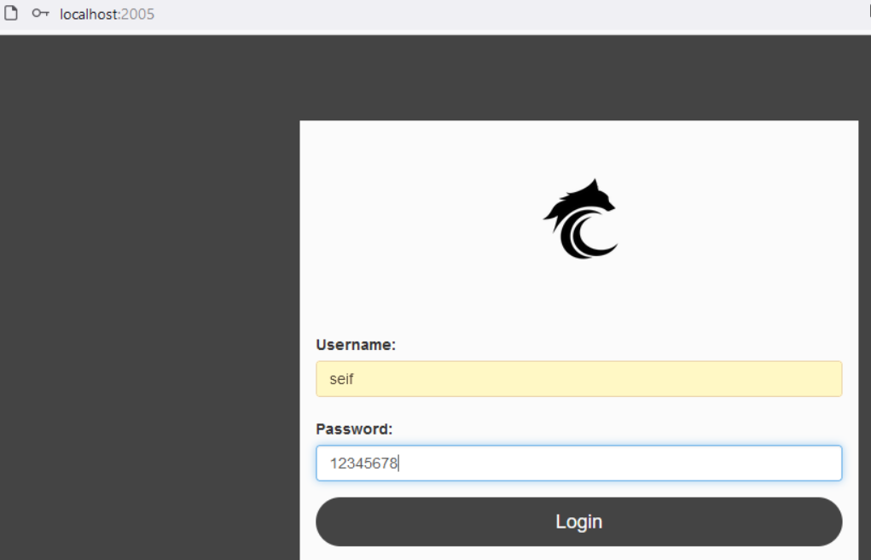

Slide 15
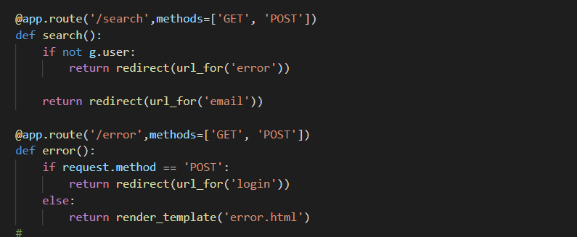
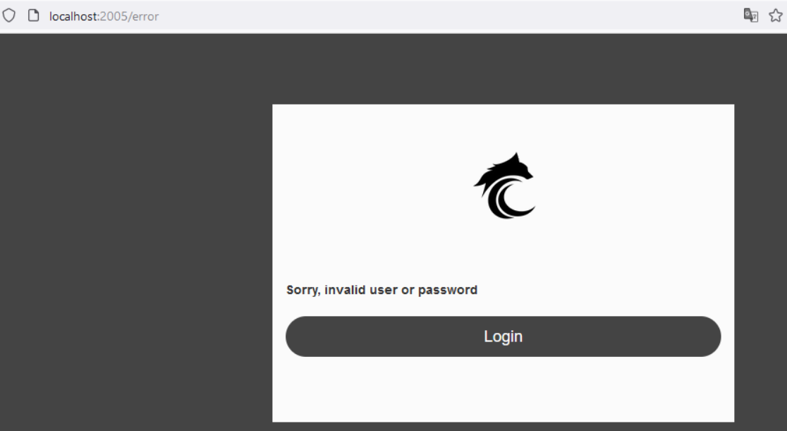

Slide 16
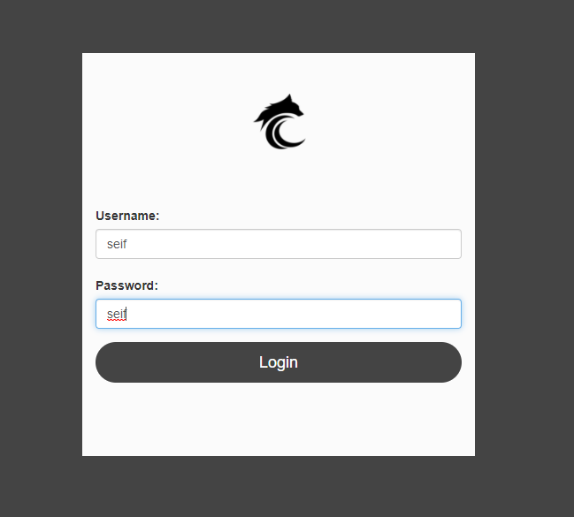

Slide 17
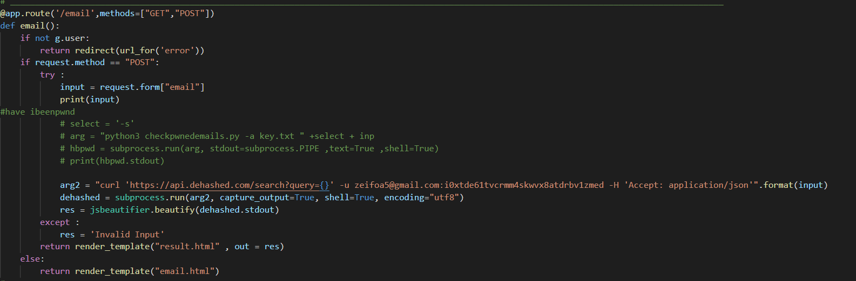
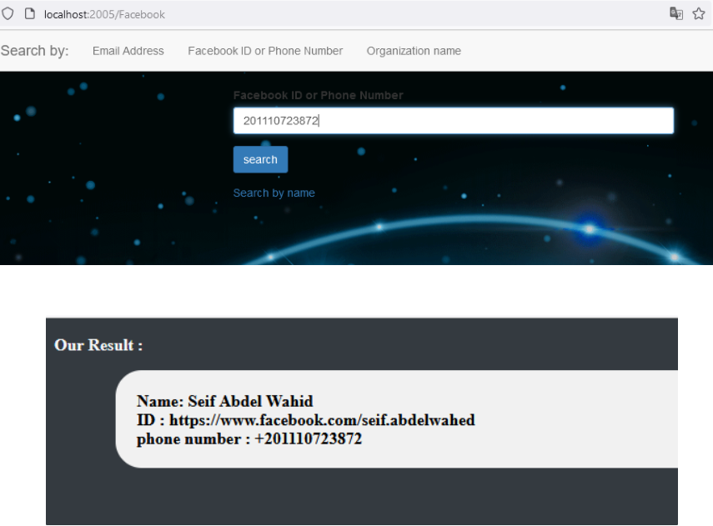

Slide 18
Thanks

